Slide 1
Communicating for Quality
Jon Allen
Principal Quality Engineer
Red Hat

Slide 2
Group Testing Session

Slide 3
Let’s make quality a given.

Slide 4
Communicating:
with different groups
across your whole team
in special situations

Slide 5
Communicating:
with different groups

Slide 6
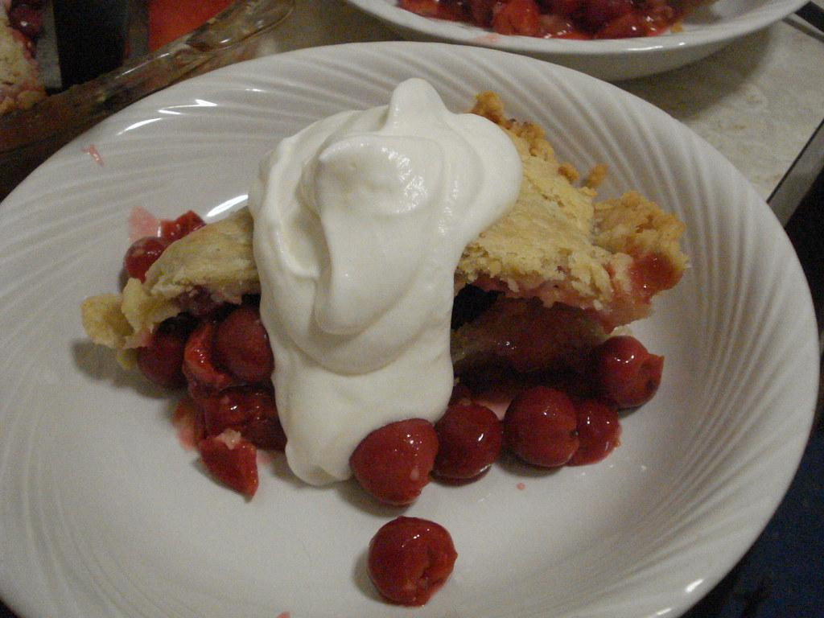
...with Devs and Ops
"PieWithCream2" by YoAmes is licensed under CC BY-SA 2.0

Slide 7
...with Devs and Ops
be respectful
do your homework, then ask
debug, then ask
join in design reviews
join in code reviews
share a language
KEEP LEARNING, ALWAYS
and share that knowledge
help them advocate for what they (and you) need

Slide 8
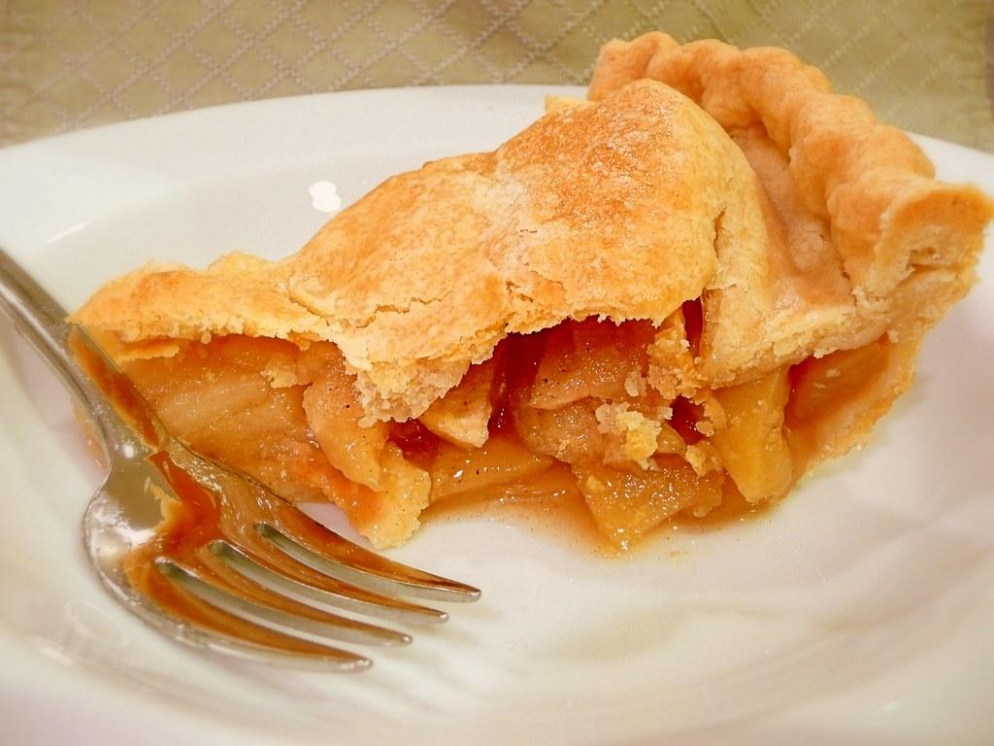
...with Business Analysts, Scrum Masters, and Agile Coaches
"Slice of Apple Pie" by bkajino is licensed under CC BY-NC 2.0

Slide 9

"Police Crime Scene Tape" by JobsForFelonsHub is licensed under CC BY 2.0

Slide 10
...with Business Analysts, Scrum Masters, and Agile Coaches
4 essential BA interactions:
Discovery
Grooming
BDD
3 Amigos
agree on Definition of Done and gating/exit criteria
regular check-ins to keep improving velocity
they have helpful metrics

Slide 11
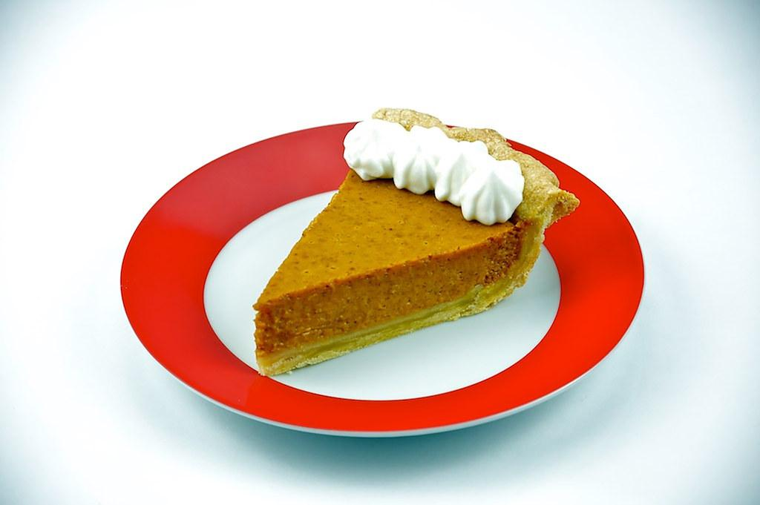
...with Product Owners
"pumpkin pie" by Alachua County is licensed under CC BY 2.0

Slide 12
...with Product Owners
first establish a connection
get customer stories
tell them your story
build trust

Slide 13
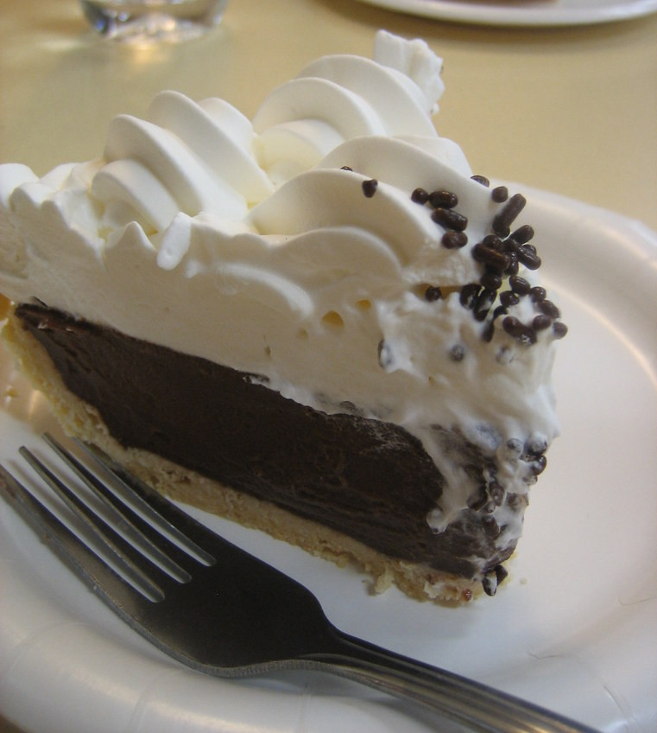
...with other testers
"Nation's Giant Hamburgers - Late Night Dessert" by BrownGuacamole is licensed under CC BY-ND 2.0

Slide 14
...with other Testers
on your team:
regular sync
other comms channels
outside your team:
keep abreast, and share your work too
build community
DIY local quality events
QECamp
Please see opentestcon.org !!!
virtual conferences, webinars
create comms

Slide 15
Communicating:
with different groups
across your whole team

Slide 16
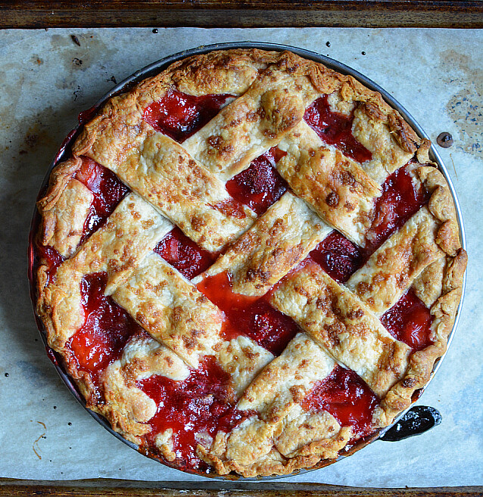
...with the whole team
"Best Strawberry Pie Recipe" by Andrea_Nguyen is licensed under CC BY 2.0

Slide 17
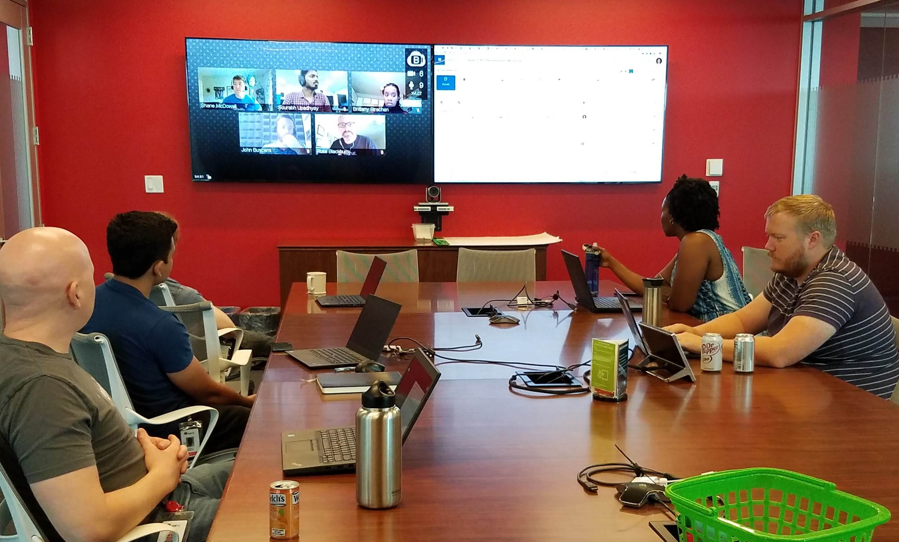
Team Meeting

Slide 18
...with your whole team
influence the rituals!
is quality getting its due?
ask good grooming questions, with the right spirit
be prepared!
be able to say, “I don’t know”
it’s okay to be wrong
be able to change your mind
be humble
LISTEN
these behaviors are contagious

Slide 19
...with your whole team
what is your team structure?
organizationally
geographically
how to compensate for challenges?
team-building
lightning talks
IRC karma and rewards
master the timezones!
video

Slide 20
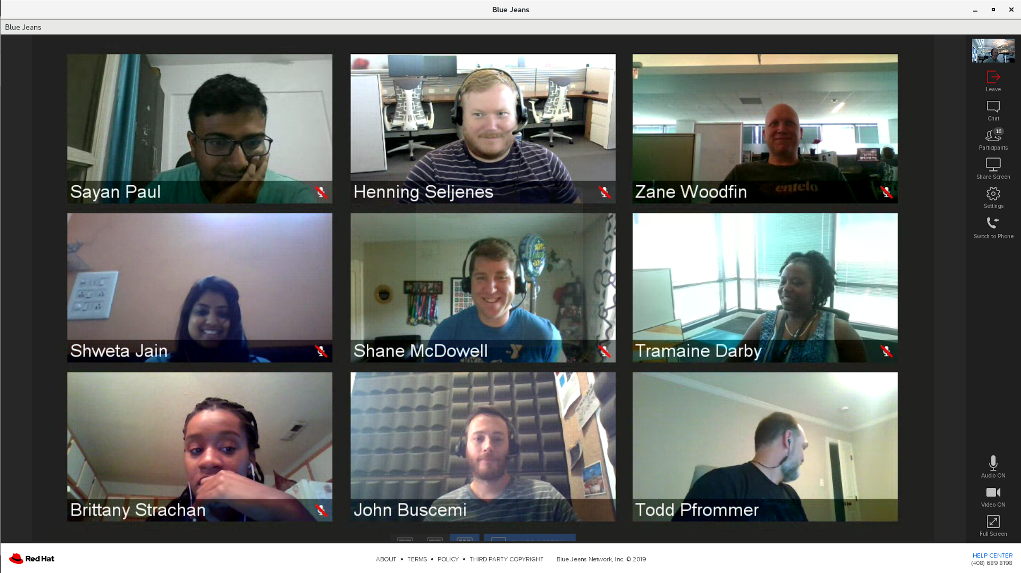

Slide 21
...with your whole team
what is your team culture?
trust level
handling mistaeks
supporting AND challenging?
It’s not my job!
who owns the bugs?

Slide 22
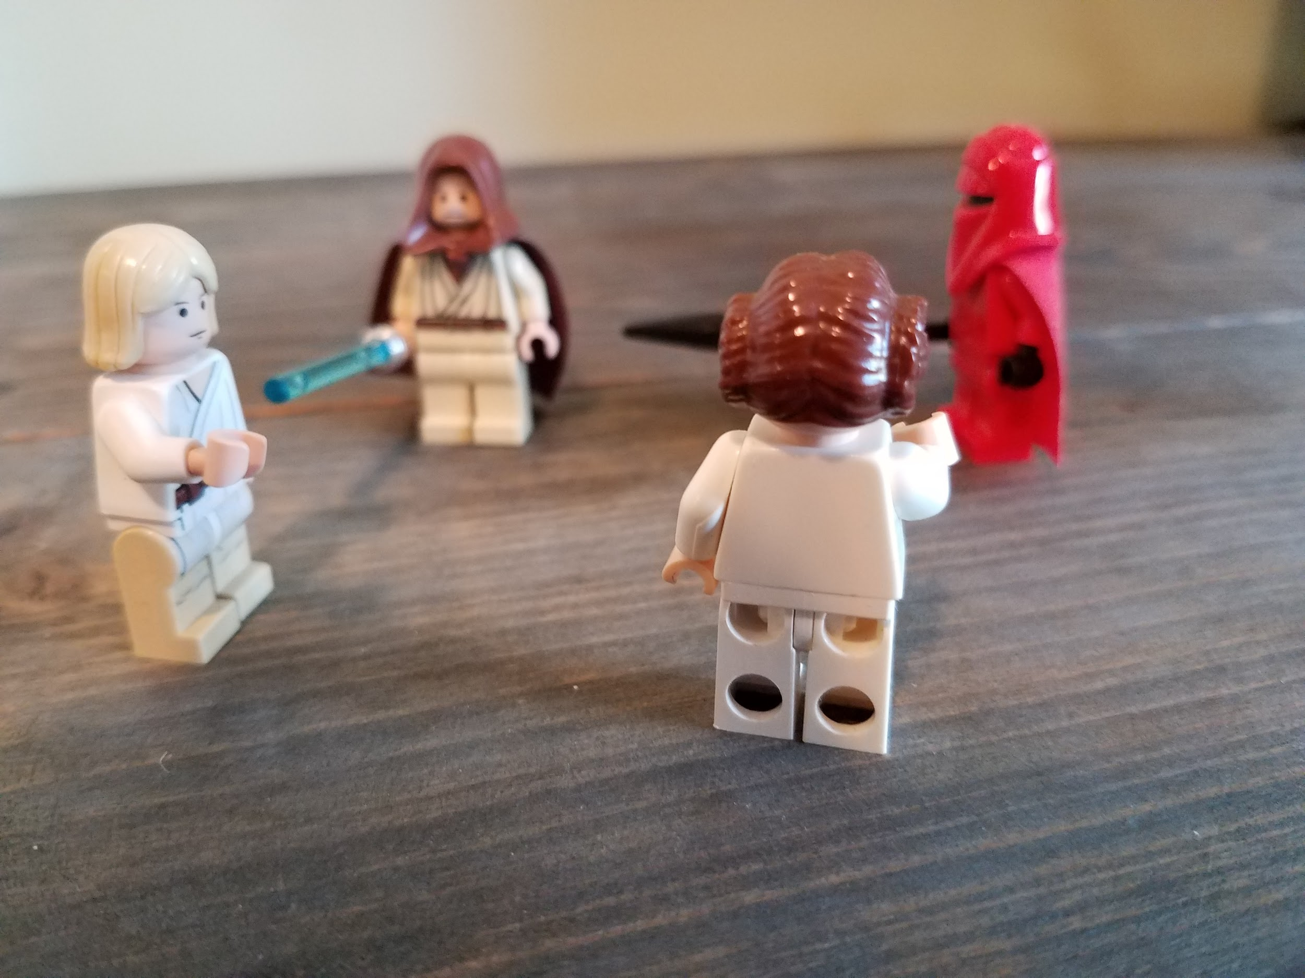

Slide 23
...with your whole team
what is your team culture?
trust level
handling mistaeks
supporting AND challenging?
It’s not my job!
who owns the bugs?
is it terminal?

Slide 24
Communicating:
with different groups
across your whole team
in special situations

Slide 25

...in special situations
"Wedding Cake" by ntwilkie is licensed under CC BY-NC 2.0

Slide 26
...in special situations
informal communication
bad communication!
difficult communication

Slide 27
...in special situations
informal communication
hallway, breakroom, even (gasp) in the elevator
make connections and learn stuff
intentional
brainstorming break
...and coffee!

Slide 28

"Zendo Cortado" by uıɐɾ ʞ ʇɐɯɐs is licensed under CC BY-SA 2.0

Slide 29
...in special situations
bad communication!
the 20-minute, 300-line IRC exchange
go synchronous
kill your email alerts
it’s okay to say no to a chat interruption
help people use the right medium

Slide 30
...in special situations
bad communication!
the HCM (Hierarchy of Communication Modes)
human beings, in person, face to face!

Slide 31
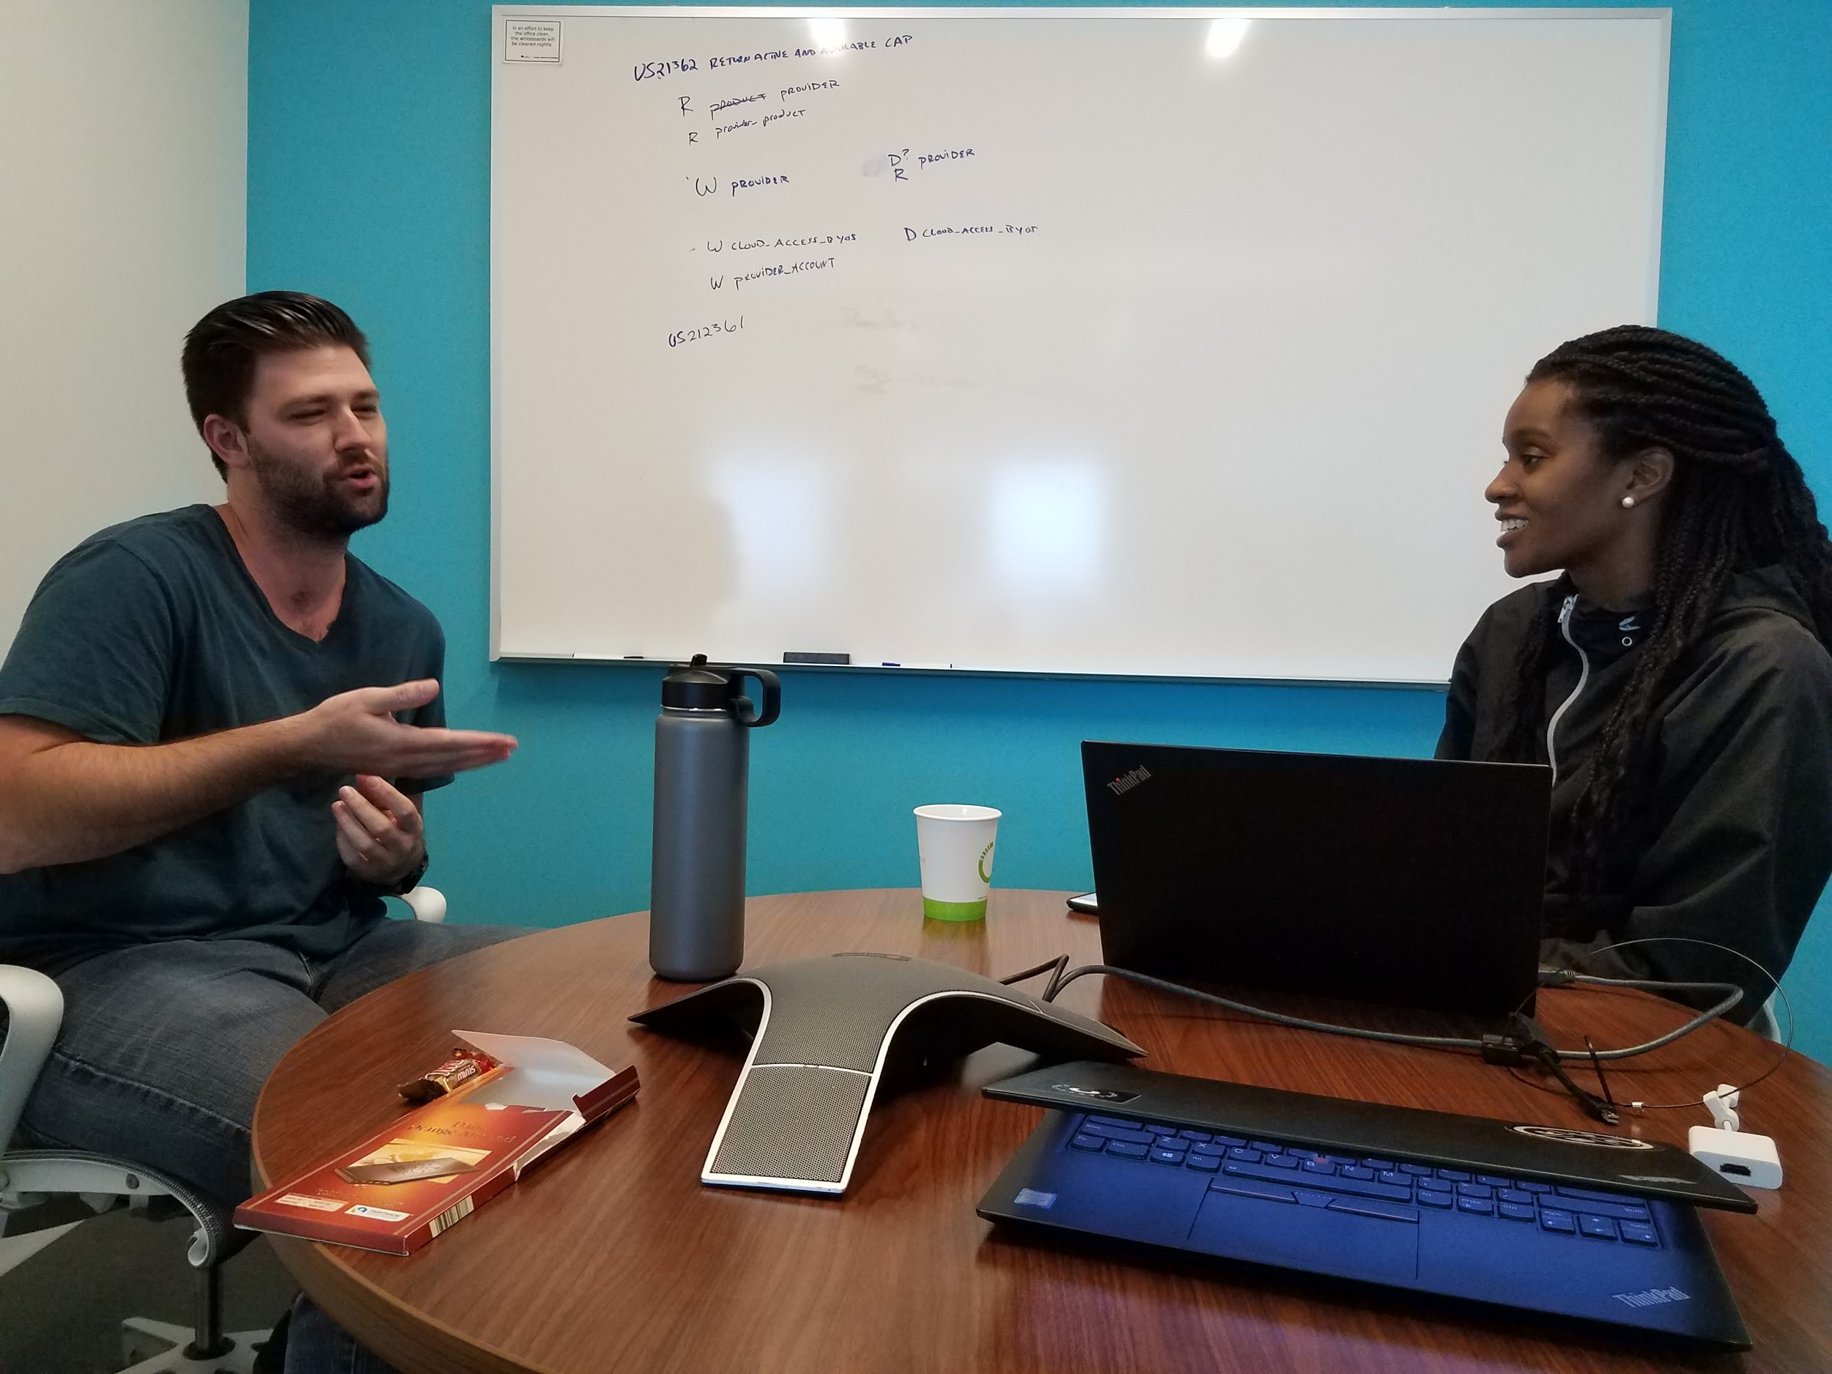

Slide 32
...in special situations
bad communication!
the HCM (Hierarchy of Communication Modes)
human beings, in person, face to face!
ii. human beings, face to face, over video

Slide 33
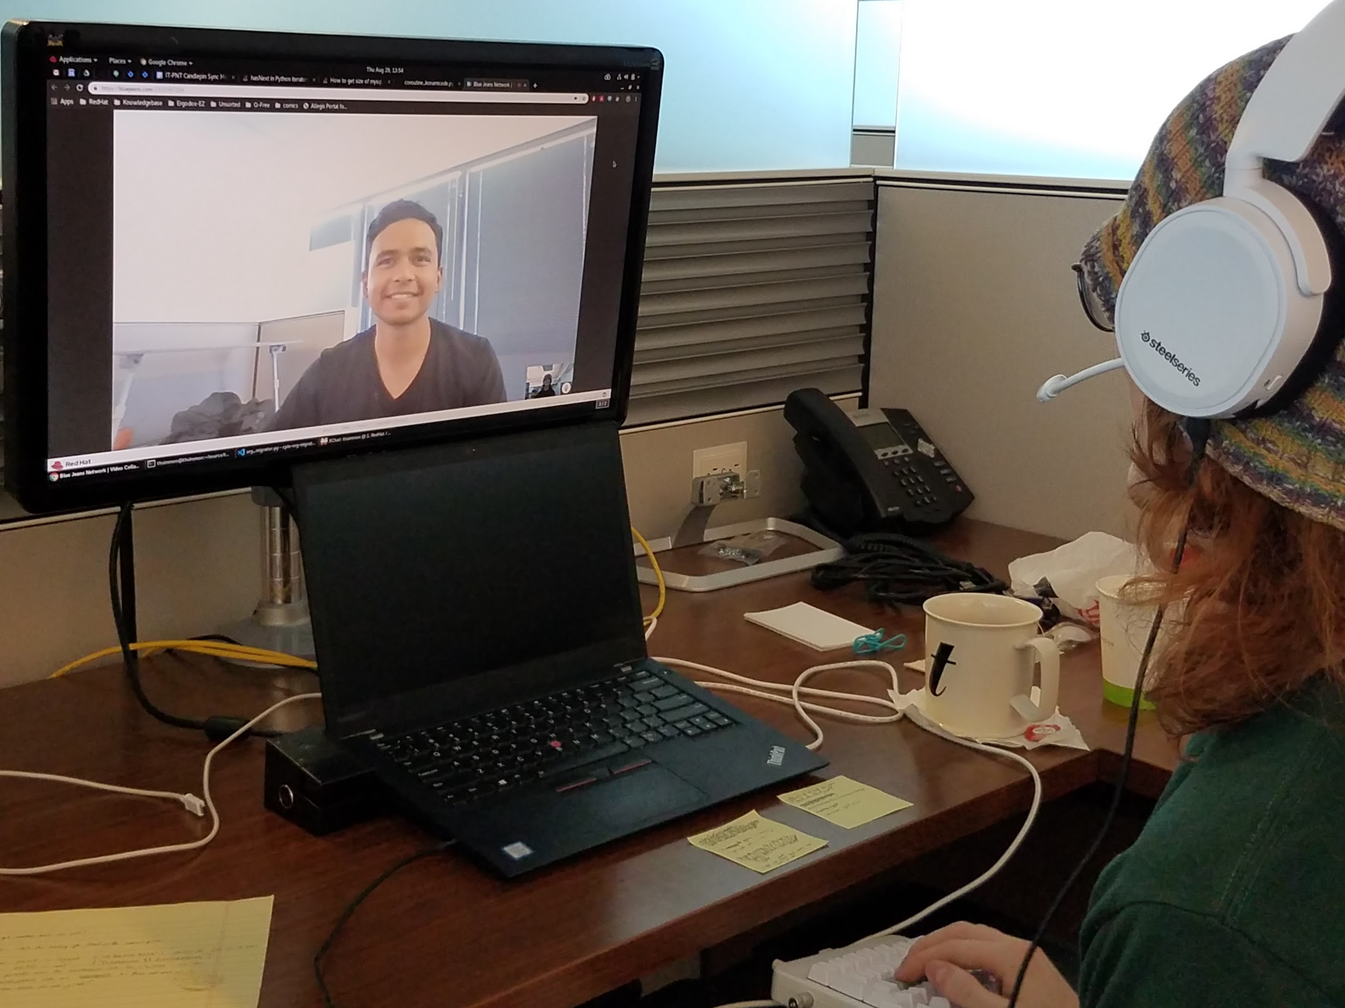

Slide 34
...in special situations
bad communication!
the HCM (Hierarchy of Communication Modes)
human beings, in person, face to face!
human beings, face to face, over video
iii. human beings, on the phone
iv. still human, pretty much, but on IRC/Gchat/etc
v. ditto for email
vi. on Twitter - the Anti-Communication Channel

Slide 35
...in special situations
bad communication!
How’s your audio, by the way?

Slide 36
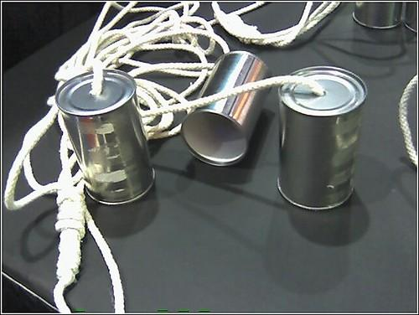
"Long life Phone" by Dave Mathews is licensed under CC BY-SA 2.0

Slide 37
...in special situations
difficult communication
when you feel attacked
breathe
assume positive intent
look for the good
in conflicts over testing

Slide 38
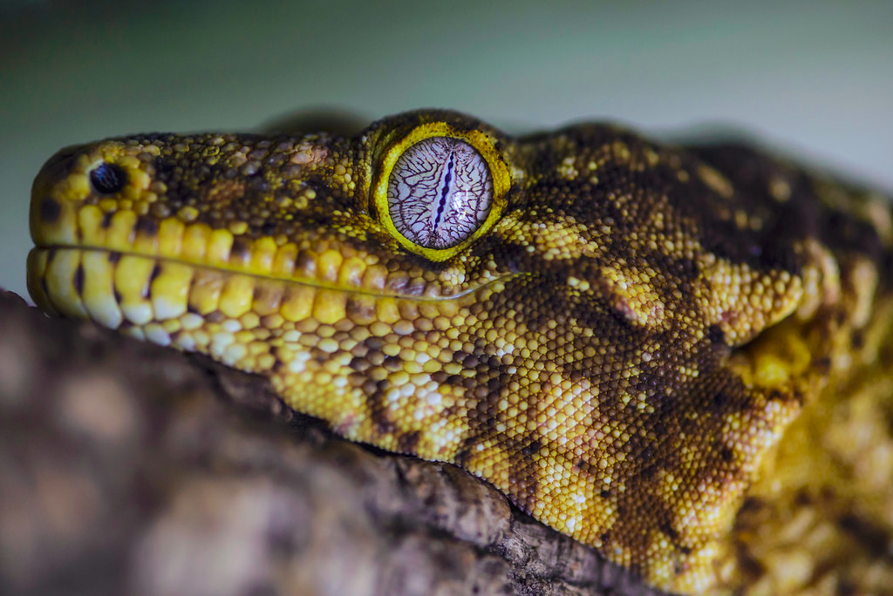
"New Caledonian giant gecko (Rhacodactylus leachianus)" by hape662 is licensed under CC BY 2.0

Slide 39
...in special situations
difficult communication
when you feel attacked
breathe
assume positive intent
look for the good
in conflicts over testing
see above
look for a third way

Slide 40
...in special situations
communicating as an introvert

Slide 41
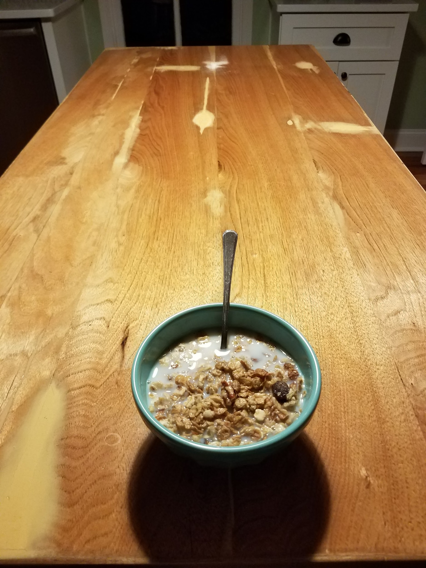

Slide 42
...in special situations
communicating as an introvert
I know how it feels
Toastmasters
Lightning talks
Be patient with yourself (and others)
Practice
Great software *does* require communication...

Slide 43
Q&A

Slide 44
THANK YOU
Please fill out an evaluation
and then go make some quality happen!
Jon Allen
#apexswqa
apexswqa@gmail.com
https://github.com/apexswqa/Slides/tree/master/conferences/SQuAD

